Slide 1
Setting up the media
Kusal Bista

Slide 2
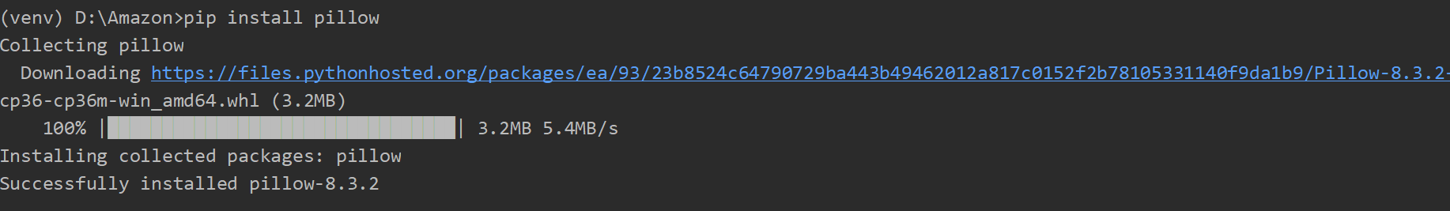
Setting up the media
In most of the websites, we often deal with media data such as images, files etc. In django we can deal with the images with the help of model field which is ImageField.
pip install pillow

Slide 3
Step 1:
Adding media_url and medial_root in the setting.py file.
MEDIA_URL = '/media/'
MEDIA_ROOT = os.path.join(BASE_DIR, 'media')
Here,
MEDIA_ROOT is for server path to store files in the computer.
MEDIA_URL is the reference URL for browser to access the files over Http.

Slide 4
Step 2
Configure the following in the project url.py. Just add the following code at last of url.py.
from django.conf.urls.static import static
from Amazon import settings # Here amazon is the project name.
if settings.DEBUG:
urlpatterns +=static(settings.STATIC_URL, document_root=settings.STATIC_URL)
urlpatterns +=static(settings.MEDIA_URL, document_root=settings.MEDIA_ROOT)

Slide 5
Step 3
Adding image field in the previous model.
class Event(models.Model):
image = models.ImageField(default='test.jpeg', null=True, upload_to='image/')
name = models.CharField(max_length=255)
date = models.DateField()
venue = models.CharField(max_length=255)
manager = models.CharField(max_length=255)
description = models.TextField()

Slide 6
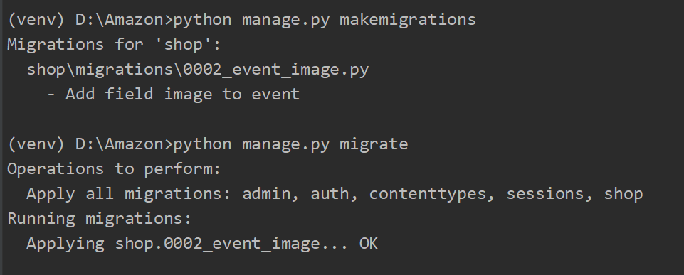
Step 4
Adding image field to database. Simply migrate by following command:
python manage.py makemigrations
python manage.py migrate

Slide 7
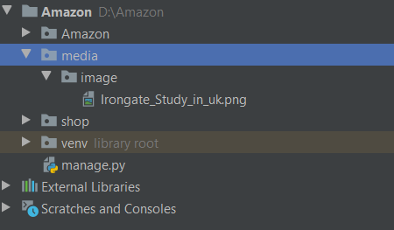
Step 5
Now the media folder is created on the project.

Slide 8
Step 6
Add the image data in event from django-admin and add the following in template.
{% for event in events %}
<img src= "{{ event.image.url }}" style="width: 200px;"> <br> #ADDED in index.html
{{ event.name }}<br>
{{ event.date }}<br>
{{ event.venue }}<br>
{{ event.manager}}<br>
{{ event.description }}<br><br>
{% endfor %}

Slide 9
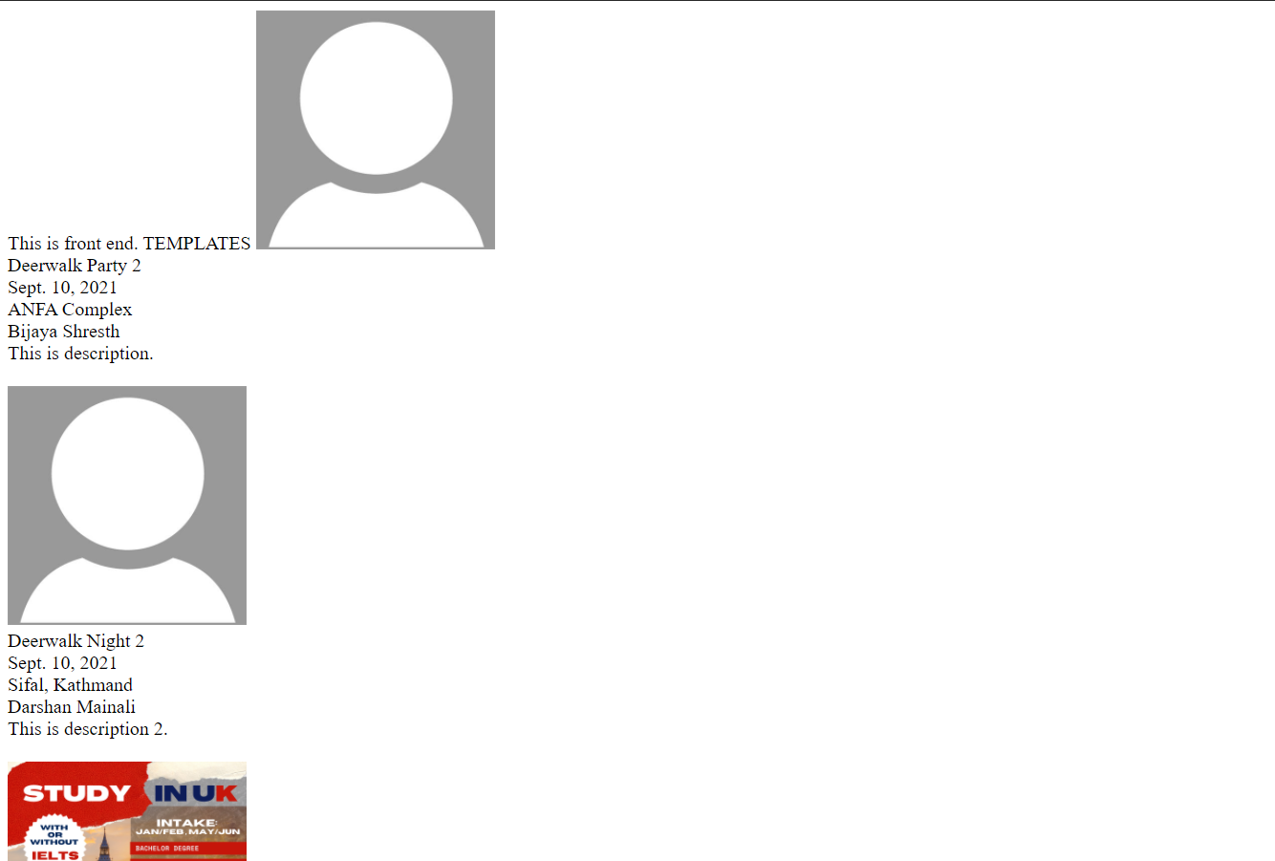
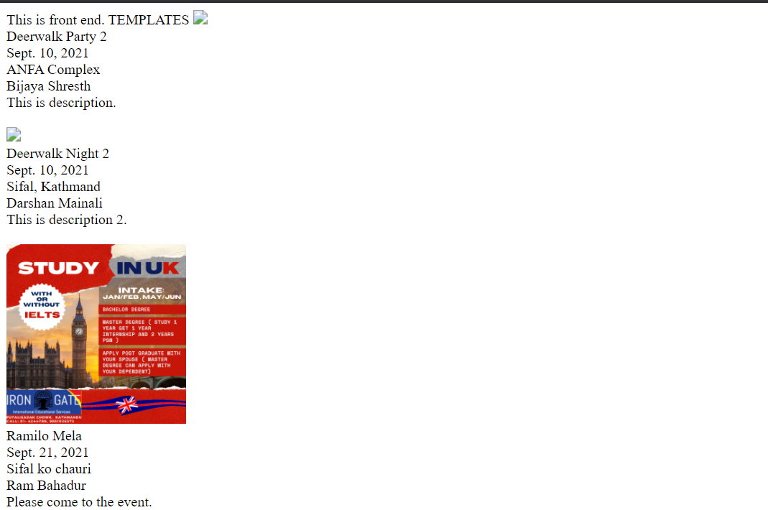
Step 7
2 image are not loaded due to previous data had no image. Now, add a test.jpeg in media to load default image.

